Slide 1
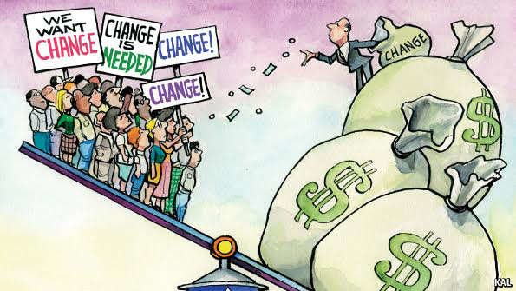
Income and Wealth Inequality
Presented By:
Adarsh Pathak (16umm001)
Amit Sagtani (16ucs034)
Ashish Gupta (16ucs048)
Priyank Mitra (16ucs140)
Raja Singhal (16ucs151)
Vibhor Agarwal (16ucs209) [WK]
Date: Oct 17, 2019

Slide 2
Difference between Income and Wealth
Income
Amount made in certain period of time.
Money from sources such as earnings, unemployment compensation, interests, social security, and rental income.
Wealth
Value of assets or capital owned by an Individual.
Notes:
Many times we interchangeably use the terms income and wealth. Does more income means more wealth? Does more wealth means more income?
Wealth: Value of assets or capital owned by an Individual.
Income: Amount made in certain period of time.Money from sources such as earnings, unemployment compensation, interests, social security, and rental income.
For example a person A has an total asset of 1 crore rupees which are in form of fixed deposits, bonds etc and he gets an interest of 7% ie 7 lakhs so

Slide 3
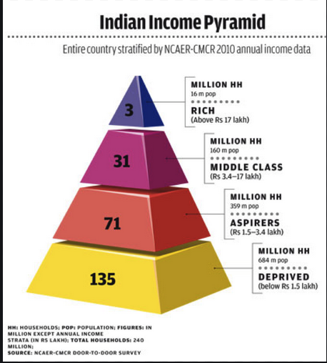
What is Inequality?
Economic inequality is the unequal distribution of income and opportunity between different groups in society.
Disparity of income or wealth between top (rich) & bottom (poor) of the Income Pyramid
Notes:
There are many types of inequality like gender in, racial in, health and political in, but we will talk about economic inequality.

Slide 4
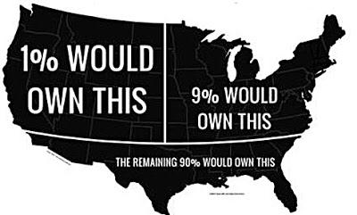
Income Inequality in USA
The richest 1% of the US population possessed about 40% of the nation’s wealth in 2016 and this share is increasing at a rapid pace.

Slide 5
Why is economic inequality prevalent in our society?
Inequality is one of hazards of capitalism.
Kill people for personal gain
Thrust them into unemployment
Push them to starve even when food available for devour
Notes:
Earthworm example (Tail of earthworm must move with head otherwise system will break)

Slide 6
Vicious Cycle of economic Inequality

Slide 7
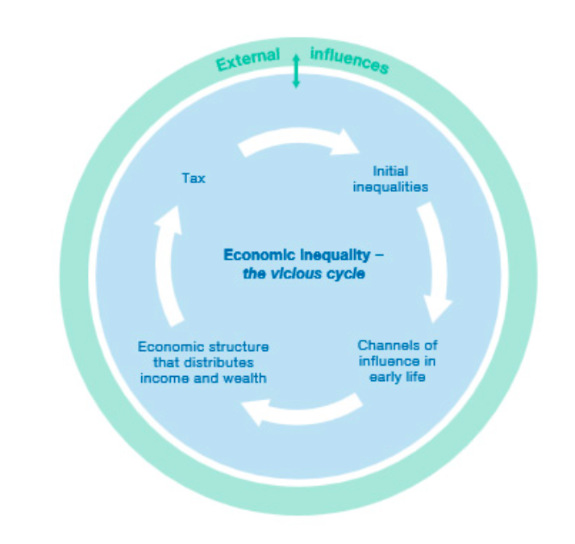

Slide 8
The circumstances we are born into shapes our opportunities from the start – from where we are born, our race and nationality, the education of our parents, and so on.
A poor start can lead to lower academic achievement throughout school, and lower wages over a lifetime.
The tax system then completes the cycle by mandating how much of our salary we actually get to keep, and whether or not we get any support or tax credit.

Slide 9
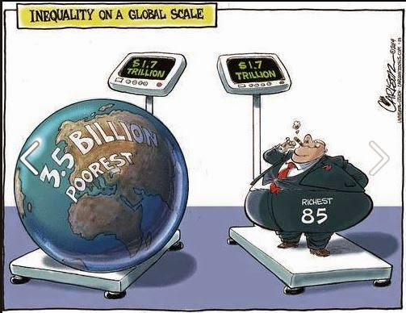
Measurement of Inequality
The Lorenz Curve
Gini Coefficient
Palma Ratio

Slide 10
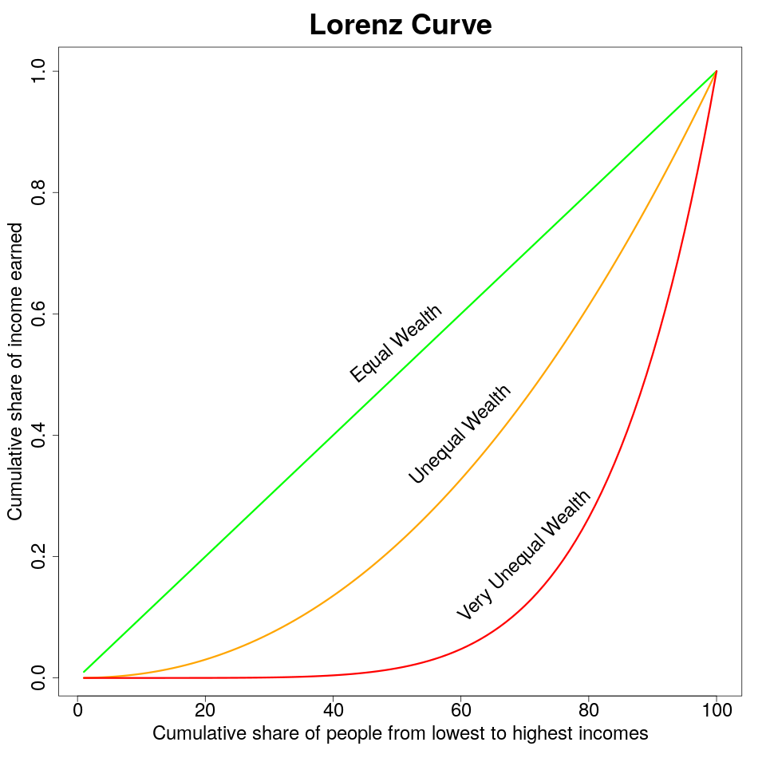
Lorenz Curve
Developed by Max O Lorenz in 1905
A curve showing the proportion of national income earned by the given percentage of the population.

Slide 11
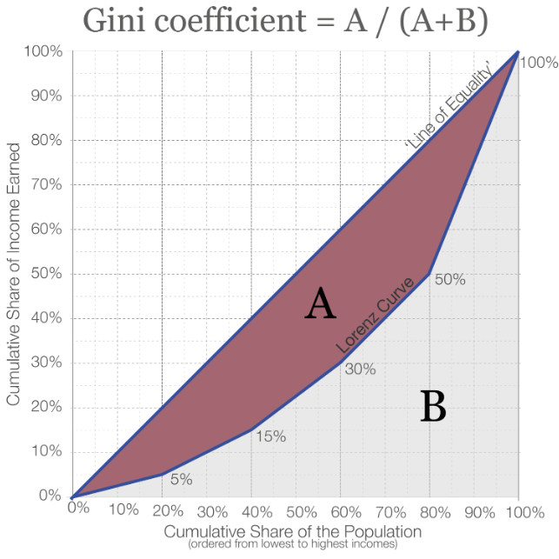
Gini Coefficient
The proportion of the area taken up by the Lorenz Curve in relation to the overall area under the line of equality.
Given by italian statistician Corrado Gini in 1912.
Gini Coefficient of-
US 0.37 (by 2018)
India 0.47 (by 2018)
China 0.51 (by 2018)

Slide 12
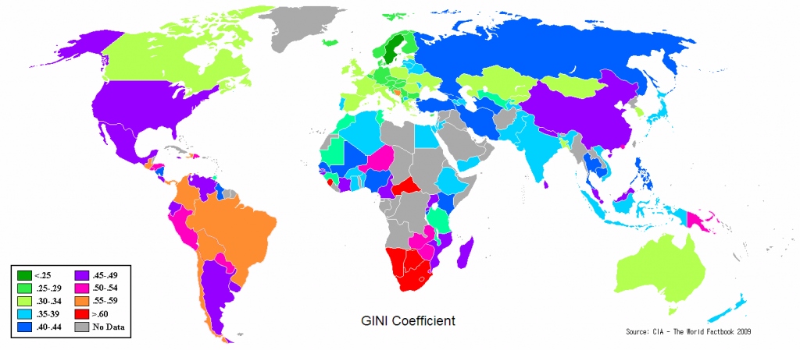
Inequality in different countries

Slide 13
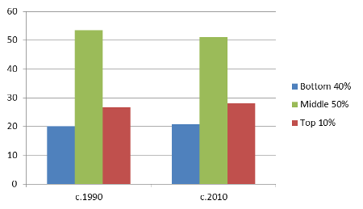
Palma Ratio
It is a ratio of income share of top 10% to that of the bottom 40%.
Given by Gabriel Palma.
Palma Ratio of
US 1.9 (by 2015)
India 4.5 (by 2015)
China 2.4 (by 2015)
Palma Ratio = Income of Richest 10% / Income of Poorest 40 %

Slide 14
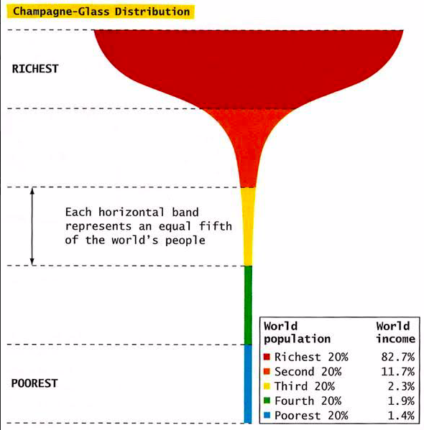

Slide 15
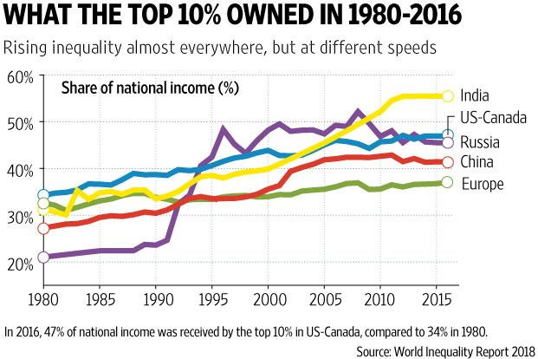

Slide 16
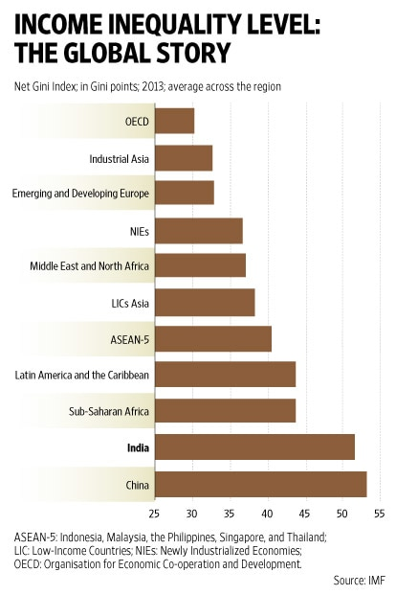

Slide 17
Risks of Inequality
Social Unrest
Lack of trust makes lower class people reluctant to work for rich people and therefore, do not add any economic value
Poor Health
Health and social problems are worse in unequal societies
Common health issues: Obesity, Mental Illness, Drug use, lower Life Expectancy, etc.
Notes:
extreme ineq. disrupts society

Slide 18
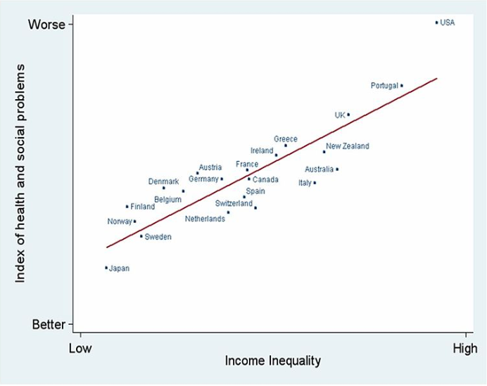
Health & Social problems are Worse in Unequal Countries

Slide 19
Income Inequality in India: An Overview
India's top 1% of the population holds 73% of the wealth.
67 crore Indians, who comprise the poorest half of the population, saw just a 1% increase in their wealth.
941 years of min wage == 1 year of max wage
5% of population living < $1.90 a day.

Slide 20
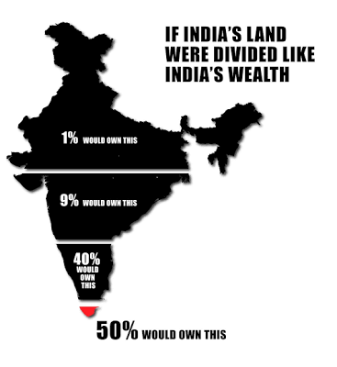

Slide 21
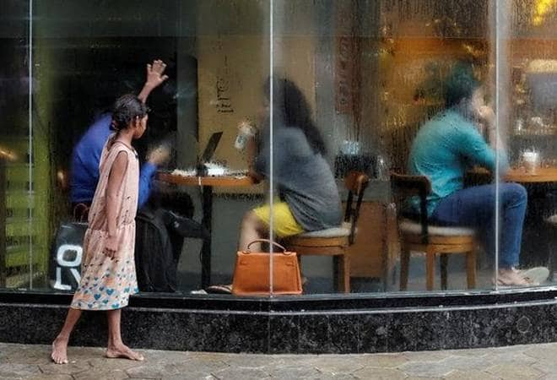
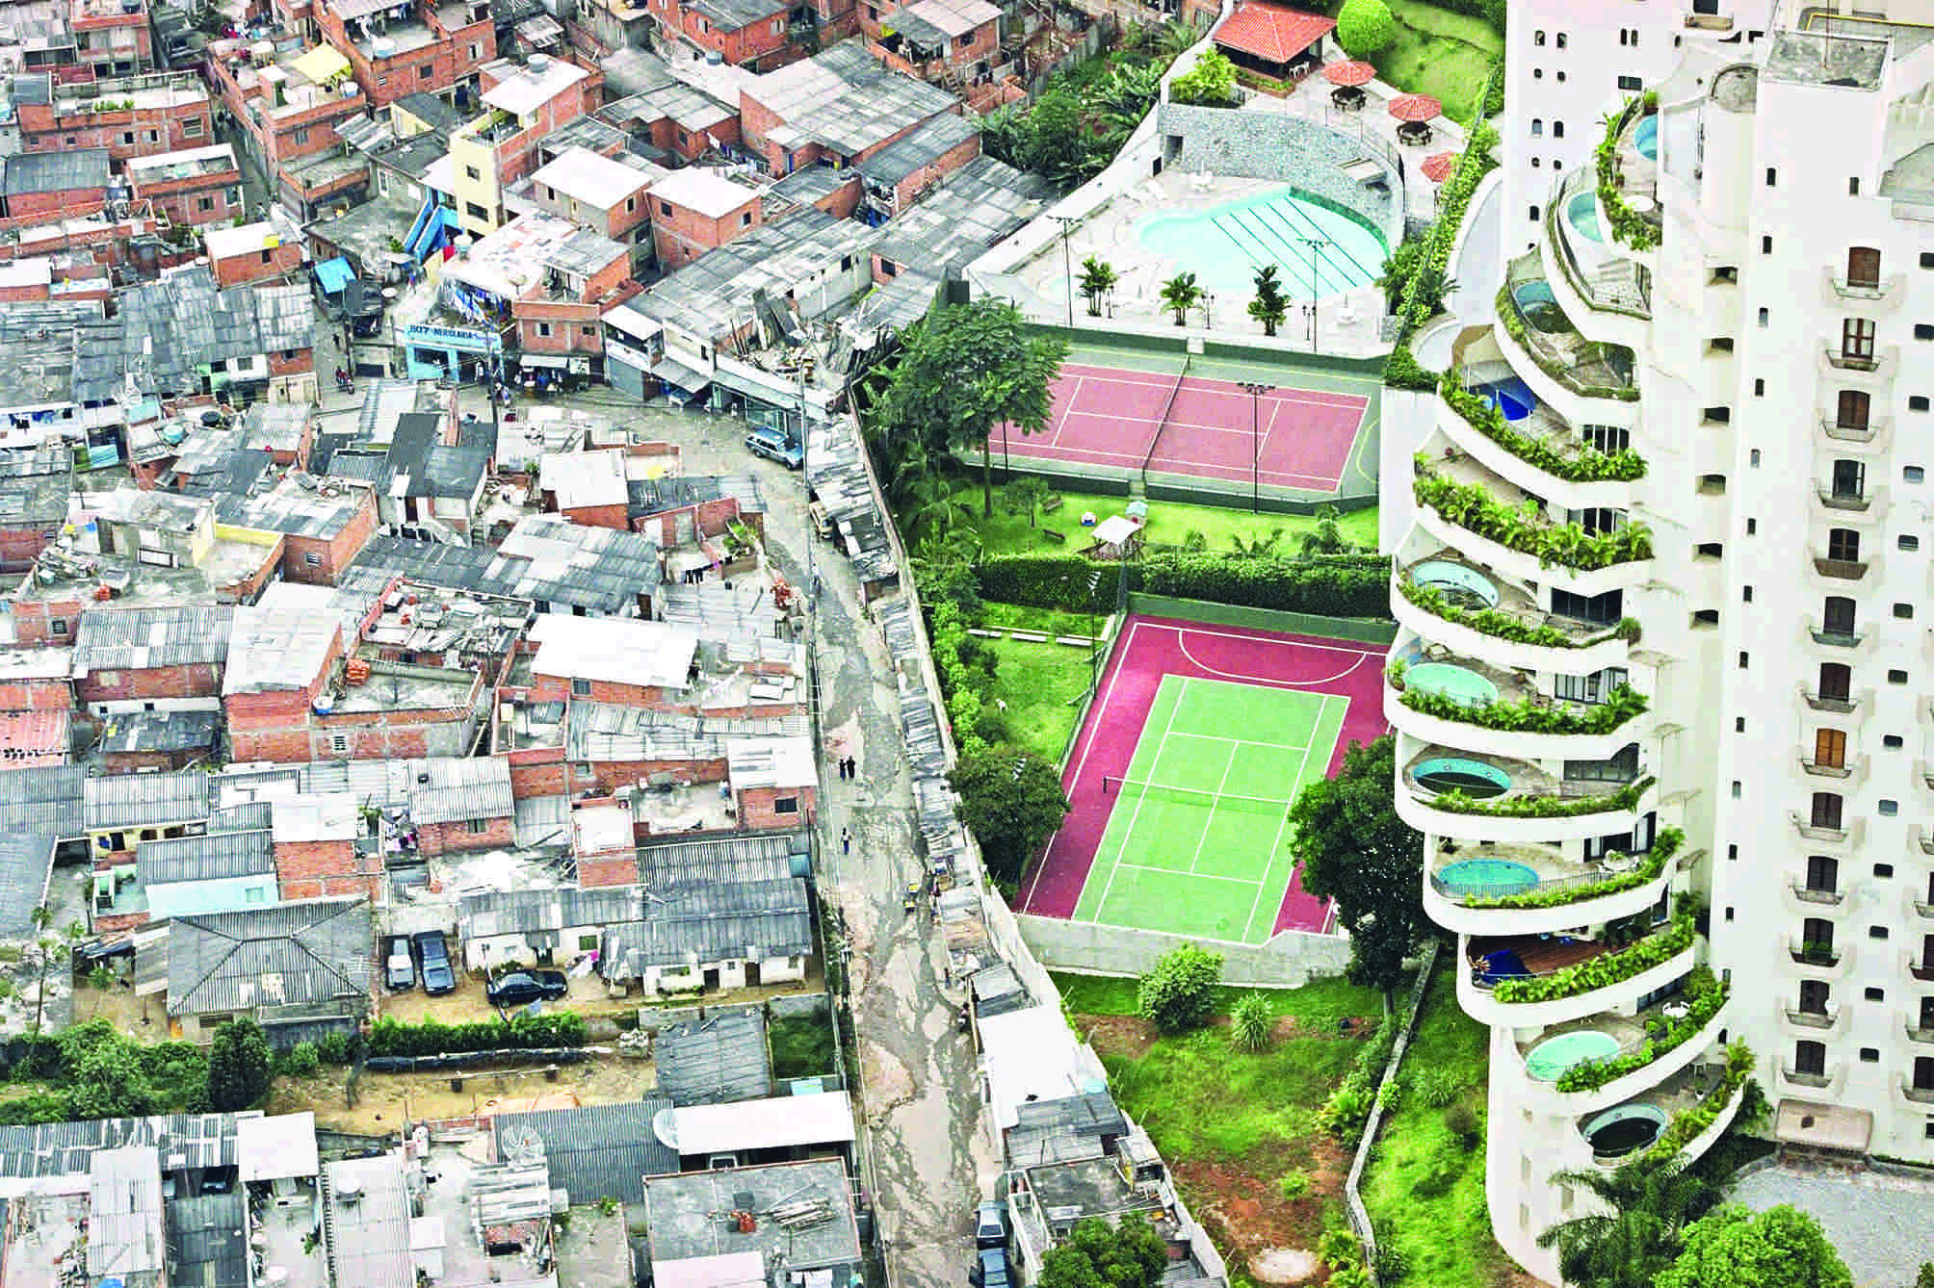
As Indian economy is getting richer and richer, the income gap in Indian society is getting wider year by year.

Slide 22
Companies are focusing on their exclusive market!
An Example -
Apple Focusing on Premium and rich sector in India.

Slide 23
Consider both Exclusive and Inclusive Market.
An Example -
Google having its services in multiple languages.

Slide 24

What IT can do to equip the lower end of the society?

Slide 25
Key Takeaways
What is Income Inequality and its causes?
Measures of Income Inequality
Consequences of Inequality
Income Inequality in India: An Overview
How IT can equip the lower end to be more productive?

Slide 26
References
Sites to visit:
https://www.investopedia.com/terms/i/income-inequality.asp
https://www.gfmag.com/global-data/economic-data/wealth-distribution-income-inequality
Wealth Inequality in America: https://www.youtube.com/watch?v=QPKKQnijnsM
https://www.slideshare.net/MANISH078/income-inequality-presentation-59859285
https://en.wikipedia.org/wiki/Economic_inequality

Slide 27
Dedication
This presentation is dedicated to BHARAT comprising of lower income people in Rural India.

Slide 28
